Slide 1

Log Query Optimization System
A Compiler-Based Approach to Efficient Log Analysis
BATCH-11
A.Sahithya 2420030369
Ch. Lasya 2420090011
M.Ramyasri 2420030353
B.Priyamvada 2420030495

Slide 2

The Problem: Log Data at Scale
Exponential Growth
Log files expand continuously with system activity, rapidly outpacing manual management capacity.
Inefficient Manual Queries
Without optimization, queries become resource-intensive operations that degrade system performance.
Hidden Delays
Searching large, unstructured datasets without a systematic approach introduces unacceptable latency.

Slide 3
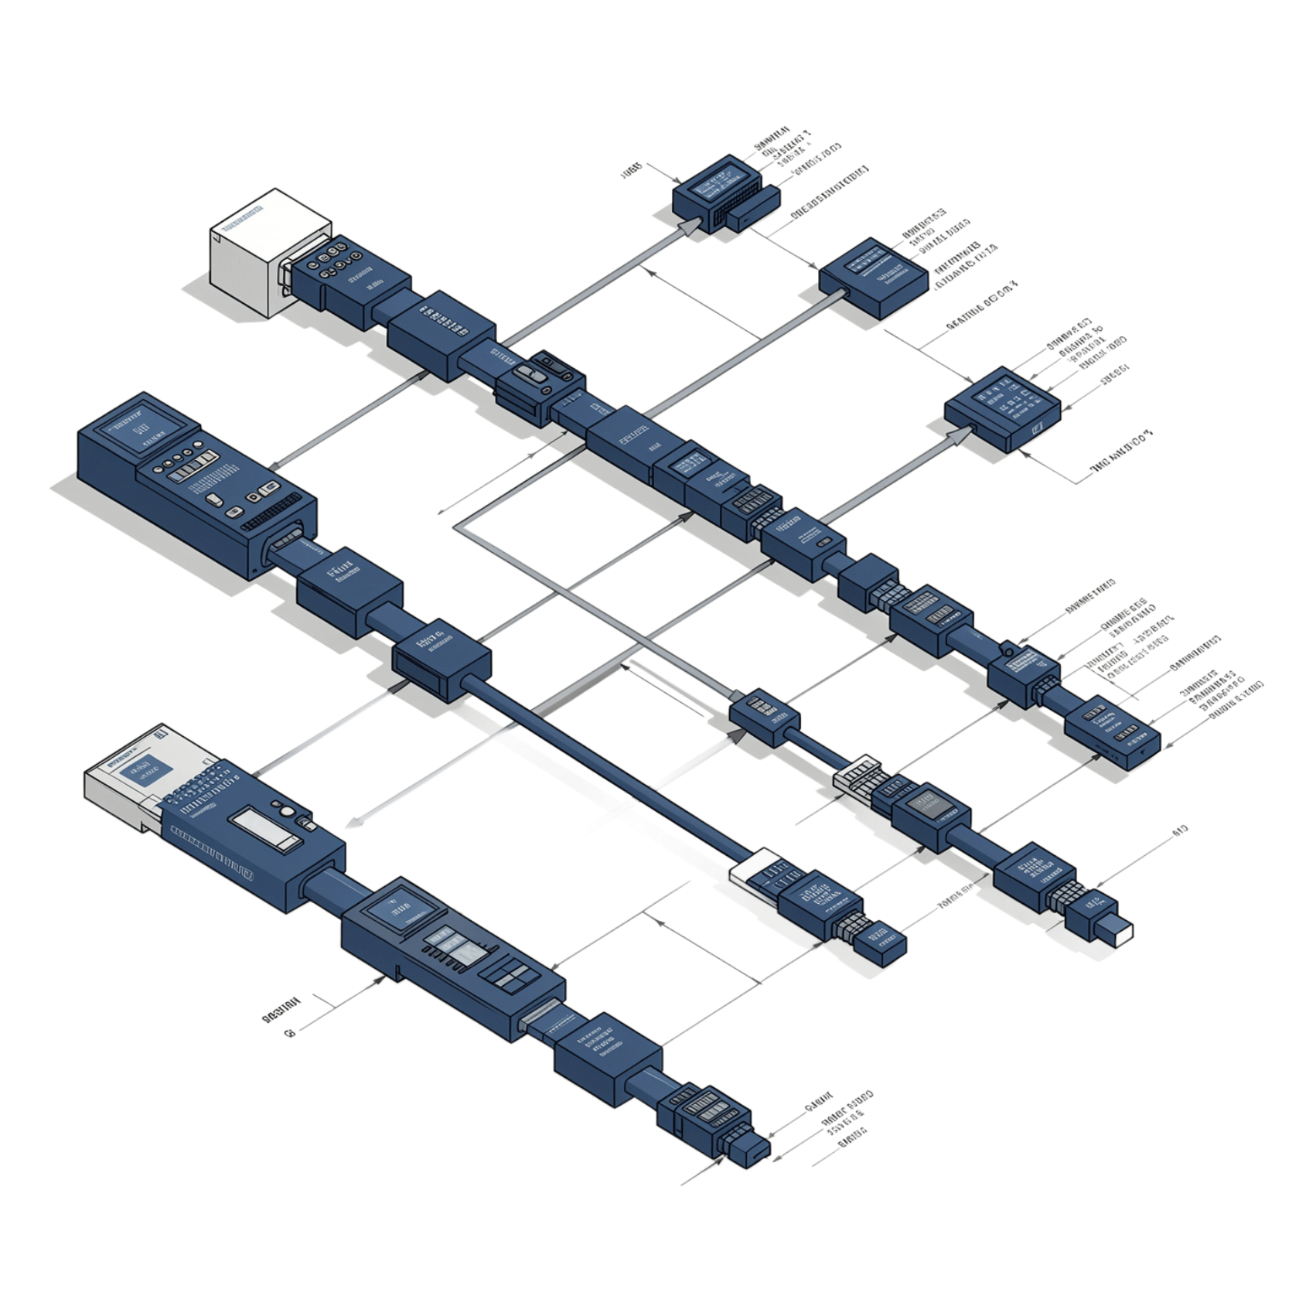
Project Vision
Applying Compiler Design to Log Analysis
The core insight of this research is that log-query processing is structurally analogous to language compilation — and can benefit from the same rigorous, phase-based treatment.
Structured Pipeline
Automated Analysis
Principled Foundation
Lexical → Syntax → Semantic → Optimization
Enable faster, cleaner queries through systematic processing
Ground log analysis in decades of compiler research

Slide 4


The Compiler Pipeline
Lexical
Syntax
Semantic
Optimization
Each phase mirrors a classical compiler stage, forming a rigorous end-to-end processing architecture for log queries.

Slide 5


Why Existing Systems Fall Short
Critical Gaps in Current Tooling
No Structured Error Detection
Redundancy Persists
Duplicate or contradictory conditions are executed without question.
Errors in query logic remain silent and hidden from the analyst.
No Expression Simplification
Opaque Processing
No visibility into intermediate query-processing stages for debugging or auditing.
Complex logical expressions are evaluated as-is, wasting compute cycles.

Slide 6

The Optimization Advantage
Redundancy Elimination
Expression Simplification
Automatically detects and removes duplicate or contradictory conditions before query execution.
Applies Boolean algebra and rewriting rules to reduce logical complexity prior to evaluation.
Filter Reordering
Performance Gains
Arranges filtering operations to maximize early pruning and minimize data traversal.
Collectively reduces processing time and resource consumption at scale.

Slide 7
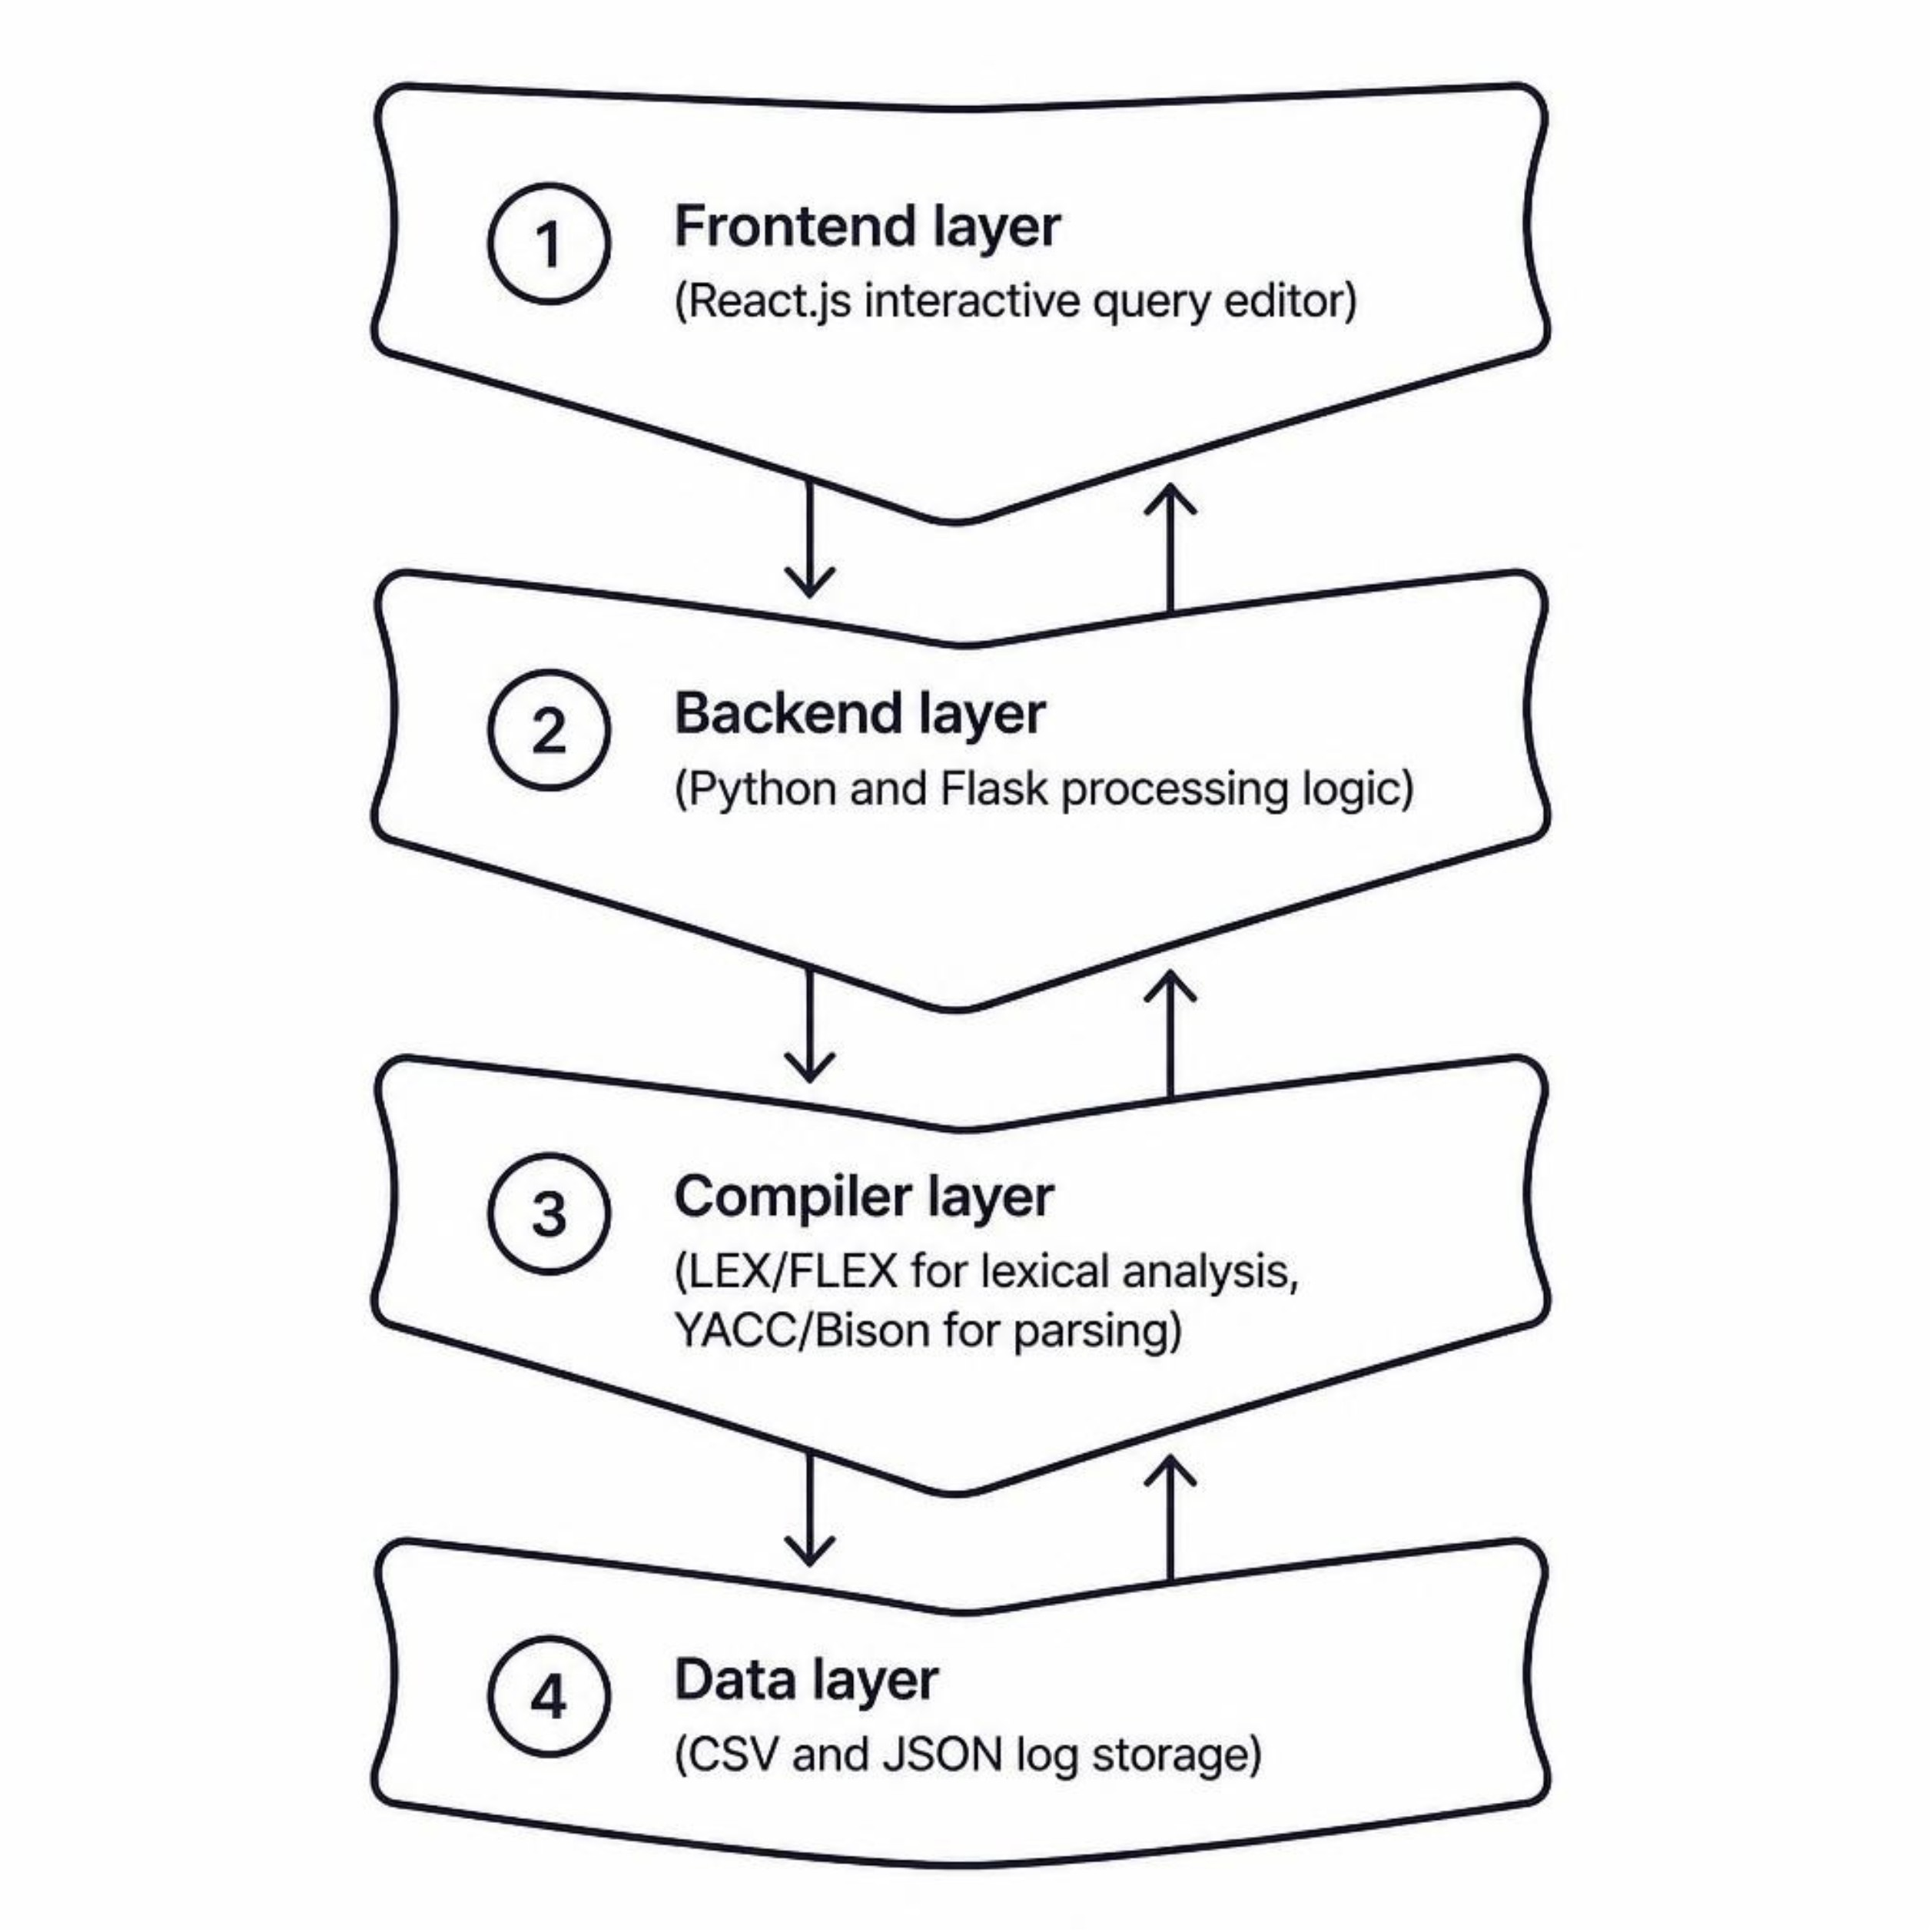

System Architecture
Technology Stack
Frontend
Backend
React.js — interactive query editor with real-time feedback
Python + Flask — orchestrates the compiler processing pipeline
Compiler Tools
Data Format
LEX/FLEX for lexical analysis; YACC/Bison for grammar parsing
CSV and JSON log storage for broad compatibility

Slide 8


Research Gap Addressed
First Dedicated System
Unified Compiler Workflow
No prior work applies a full compiler-based architecture specifically to log-query optimization — this is an unexplored intersection of compiler theory and log analytics.
All four classical compiler phases — lexical, syntax, semantic, and optimization — are integrated into one cohesive, end-to-end processing workflow.
Processing Transparency
Each stage produces observable, auditable output — giving analysts unprecedented visibility into how queries are interpreted and transformed.

Slide 9



Impact & Next Steps
Contributions & Forward Path
01
02
Practical Compiler Application
Scalable Log Analysis
Demonstrates that compiler design principles extend naturally and powerfully beyond traditional language processing into systems analysis.
Enables significantly faster and more reliable log analysis for large-scale distributed systems.
03
Foundation for Custom Query Languages
Establishes an extensible architecture upon which domain-specific query language optimizers can be built and evaluated.
This system opens a new research direction: compiler-grounded query optimization as a first-class discipline in log analytics.

Slide 10

Thank You!

